Slide 1
Classification Tasks
What is classification?

Slide 2
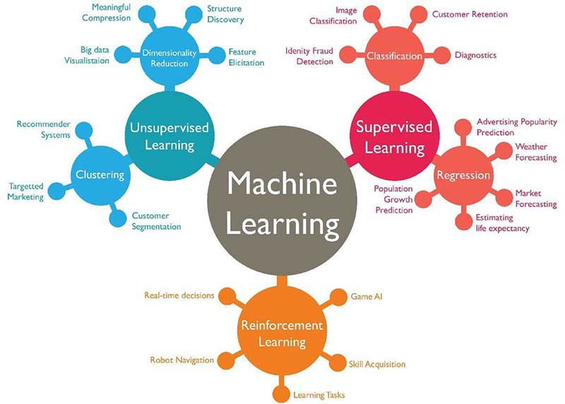
Machine Learning Types

Slide 3

Classification
When we have to predict a “categorical” target (like: sick or healthy, cat or dog, apple or banana…) we DON’T need a regressor, but a CLASSIFIER.

Slide 4
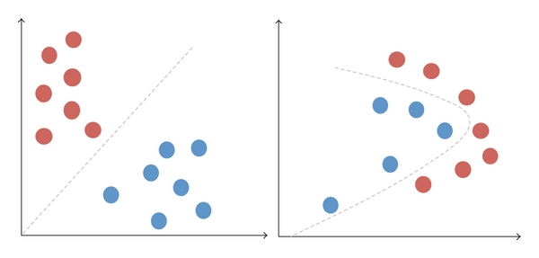
Samples Linearly Separable and not
When you can use a line (or hyperplane) to separate data in Linear Separation. In nonlinear, not.

Slide 5
KNN Algorithm

Slide 6
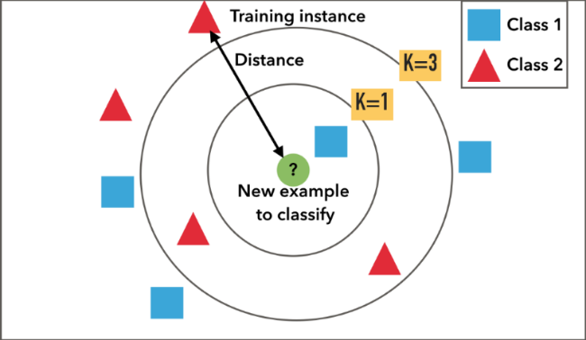
K-Nearest Neighbours (KNN)
KNN is an instance-based learning algorithm.
This means that it is has no parameters but the training is very simple because compares new problem instances with instances seen in training, which have been stored in memory.
When a new sample arrives, it calculate the distance among the new sample and the training samples. It takes the K nearest training samples and perform a majority voting.
Go to KNN notebook

Slide 7
Decision Tree
What is a Decision Tree

Slide 8
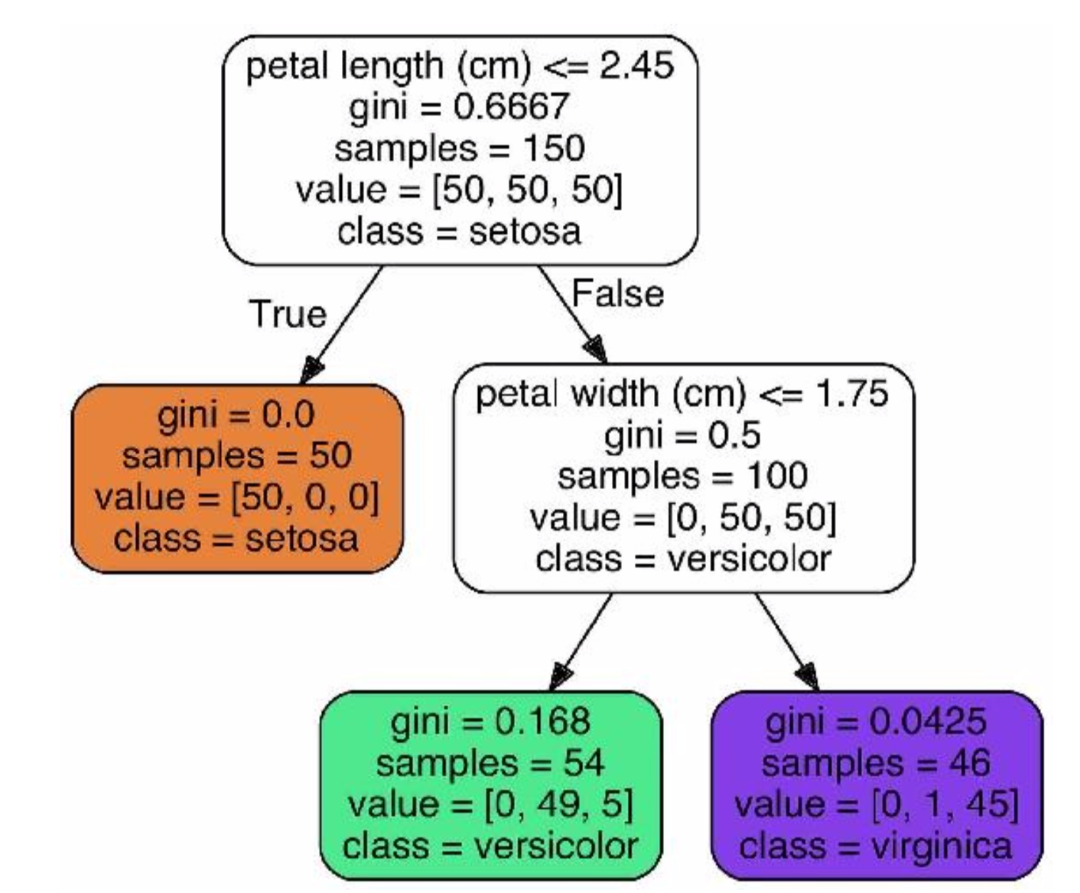
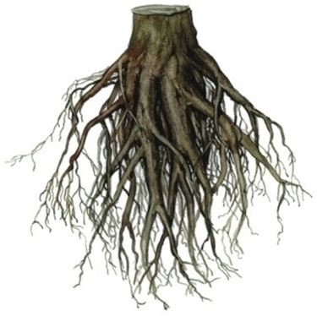

Decision Tree Classifier
Decision Tree Classifier is very simple: it tries to divide the classes step by step splitting data one feature for each step.
Starting from all the samples, it cut the data using the best features and the best cut-off value to make “purer child”.
This is called binary tree because it splits in 2 sons.
Root node
Child nodes
Leaf nodes

Slide 9
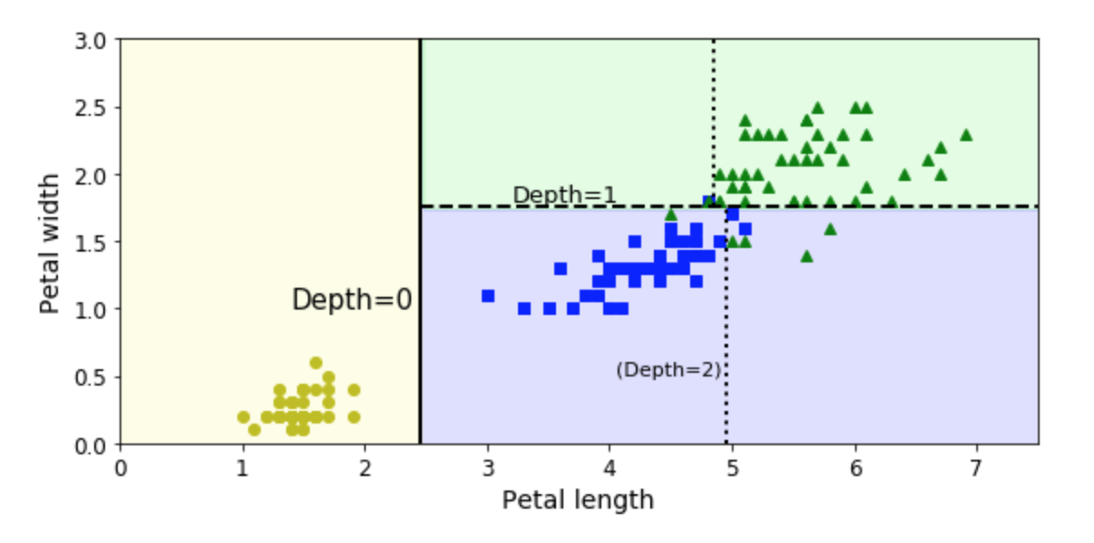
Decision Tree Classifier
Decision Tree Classifier is very simple: it tries to divide the classes step by step splitting data one feature for each step.

Slide 10
Gini Entropy Score
How to choose the best split and on which feature? It uses usually GINI Entropy Score that is a measure of the total “purity” of the sons. A split is done maximizing the “purity” of the sons.

Slide 11
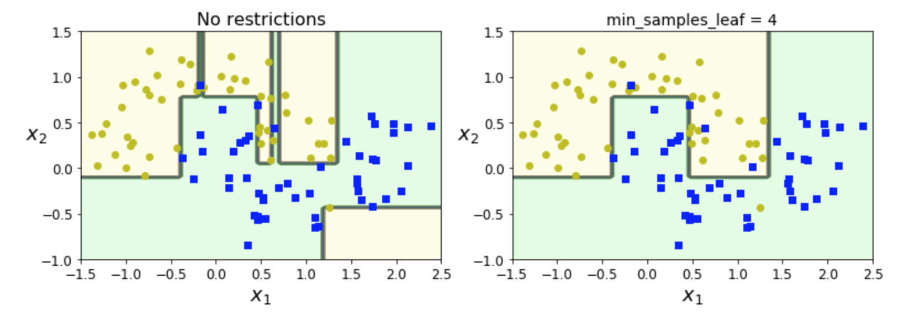
Overfitting and Regularization
With no restrictions, the tree can grow very deep, keeping on splitting again and again till having 1 sample in the sons nodes. This is overfitting, since we are specializing the nodes too much. To avoid this, we can apply some constraints like the minimum number of samples in the sons nodes.
It says: ok, split into the sons only the father has at least 4 samples.

Slide 12
How to make predictions?
When we have trained the tree, the prediction is simple:
On unseen samples, follow the rules in the tree. You will fall into a leaf node at the end.

Slide 13
High Interpretability
The Decision Tree is very interpretable: in fact, you can see and plot the rules leading to a prediction.
This is very useful for the business unit because you can explain why and how a prediction is like that.

Slide 14
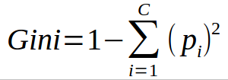
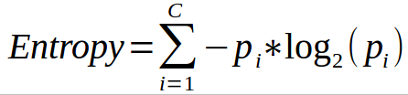
Maximizing Information Gain of the sons
This is a measure of “dis-homogeneity” in a group. The Decision Tree Classifier tries to split in order to have each time the son “purer” than the father. The Gini Index indicate the dis-homogeneity level.

Slide 15
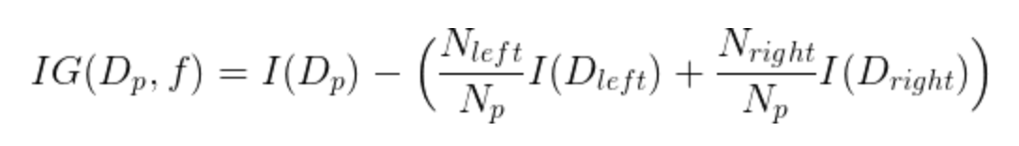
Objective function: Maximizing Information Gain of the sons
Starting from the root, the data is split on the feature that results in the largest Information Gain (IG) (explained in more detail below). In an iterative process, we then repeat this splitting procedure at each child node until the leaves are pure
Information gain is simply the delta between the impurity of the parent node and the sum of the child node impurities
Impurity Measure

Slide 16
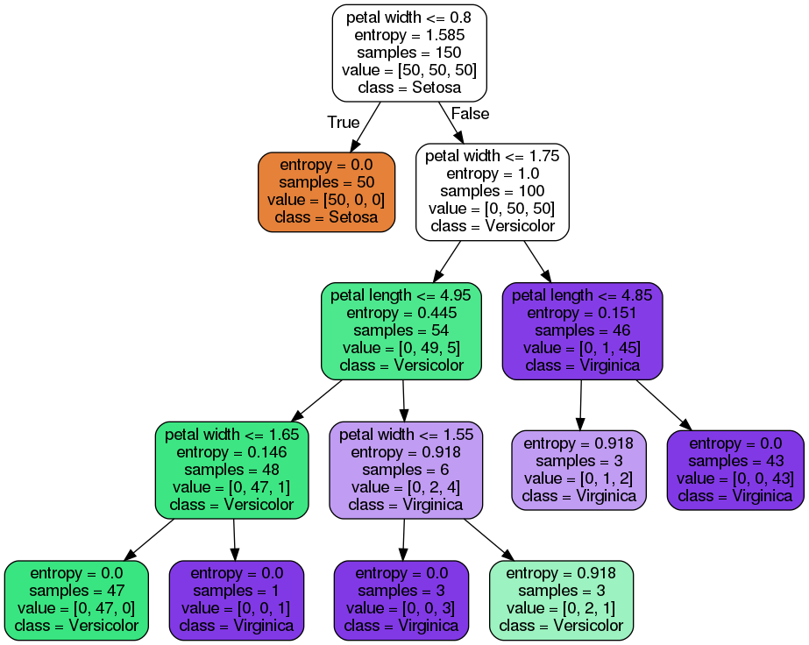
Pruning of the Tree
The Tree will grow will each leaf is pure. This can lead to overfitting making a very “specialized” tree and very deep tree. So pruning is very common, meaning that we can prevent overfitting “limiting the depth of the tree”.

Slide 17
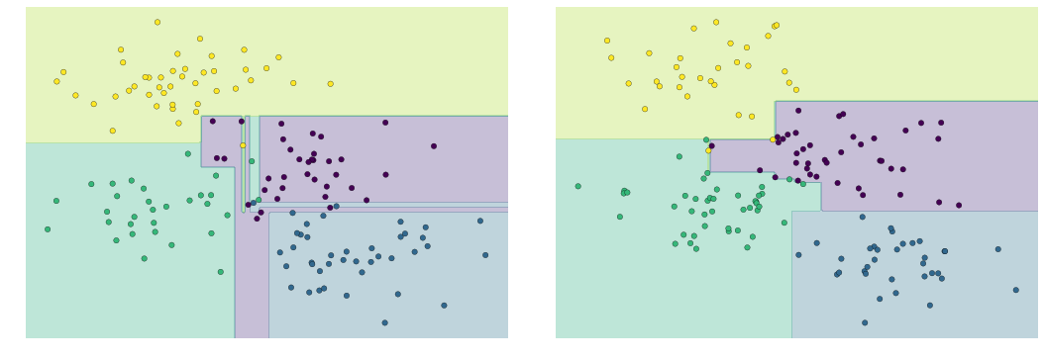
Overfitting Decision Tree
Example of Overfitting

Slide 18
The hyperparameters of Dec Tree Classifier
Random Forest can be used in Sklearn, that implements the algorithm:
Max Depth = the depth of the trees
Min_samples_split = The minimum number of samples required to split an internal node
Min_samples_leaf = The minimum number of samples required to be at a leaf node
These are the main Hyperparameters that control the flexibility of the model and control overfitting.

Slide 19
Random Forests
Many Decision Trees

Slide 20
Random Forest: Many Decision Trees
When many decision trees are created and collaborate, we have a random forest.
In random forest, train MANY decision trees with this criteria:
Each decision tree is trained only on a random subsample of the dataset (this means a subsample of samples and subsample of features). This process is called bootstrapping. In fact “bootstrapping” means: random subsample of something with repetition (in this case samples)
Once trained, the prediction is by means of Majority Voting
Support to have 10 trees in a Random Forest: 3 predict the sample as CAT and 7 as DOGS. With Mayority Voting the final predicition is DOG (7 versus 3).

Slide 21
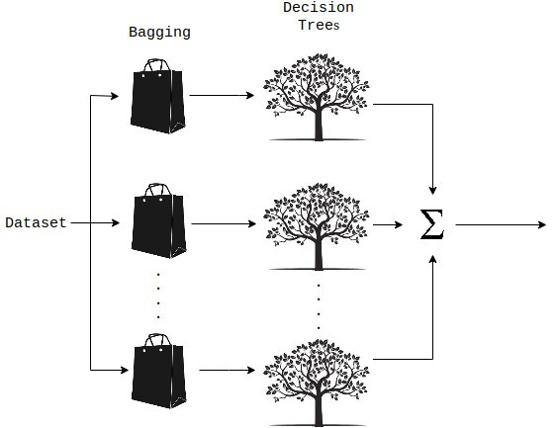
Random Forest: Many Decision Trees

Slide 22
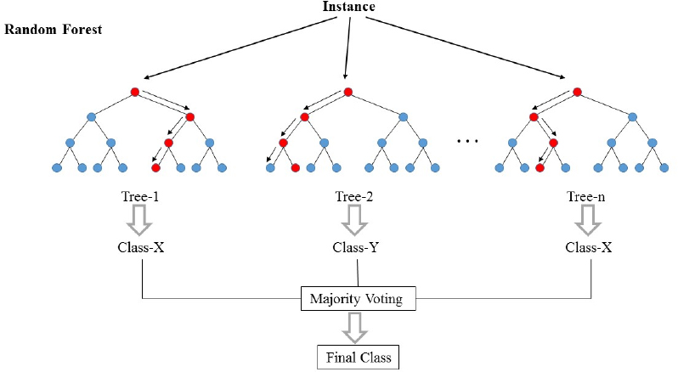
Why it works?

Slide 23
Why it works? Wisdom of the crowd and Ensemble Learning.
It works because each Tree observe the dataset from a different “angle” and they make different types of errors.
Observing the same object from different perspective is better and more powerful because each tree see a different portion of the dataset.
This is linked to the concept “Wisdom of the crowd” in which it was observed that many opinions made from 1000 people with low expertise, on average, are better than the prediction of 10 experts.
Ensemble Learning Principle: many different models collaborate; 1000 weak learning (with low accuracy) have a total accuracy much higher than 10 strong learners.

Slide 24
The hyperparameters of Random Forests
Random Forest can be used in Sklearn, that implements the algorithm:
Num estimators = the number of trees in the forest
Max Depth = the depth of the trees
Min_samples_split = The minimum number of samples required to split an internal node
Min_samples_leaf = The minimum number of samples required to be at a leaf node
These are the main Hyperparameters that control the flexibility of the model.

Slide 25
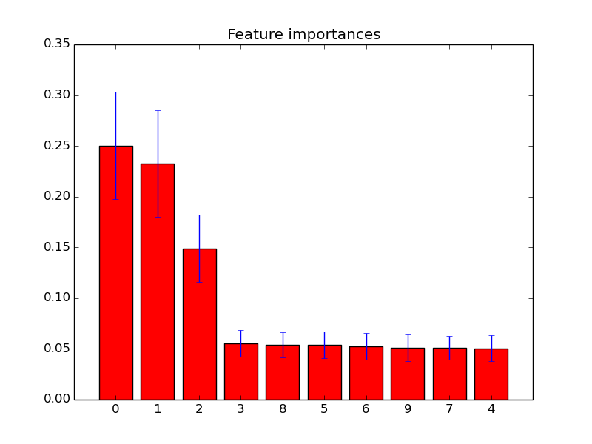
Features Importance
This is very used in practice and in an interview remember to say it.

Slide 26
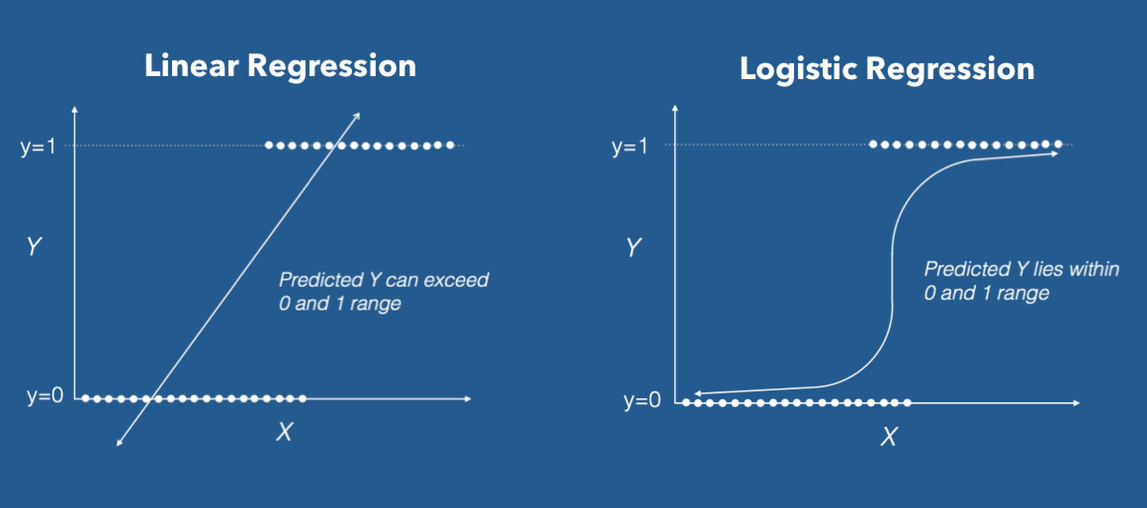
Logistic Regression
Logistic Regression is a classification algorithm based on a specific function called Sigmoid applied to a linear regression. Basically everything starts with a Linear Regression...to which it is applied a Logit Function.

Slide 27
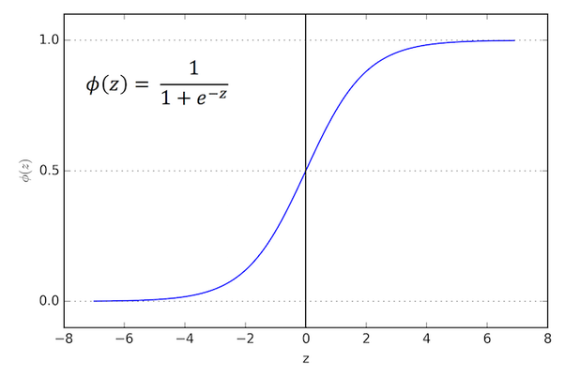
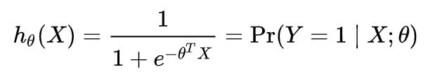
Logit function
The Linear Regression is fitted to the data and then transformed with the Logit Function.
Output of the Logistic Regression measure the “probability that sample x belongs to class 1”.
In fact, to work, the target MUST BE only 0 and 1 (numerical values) in binary classification.

Slide 28
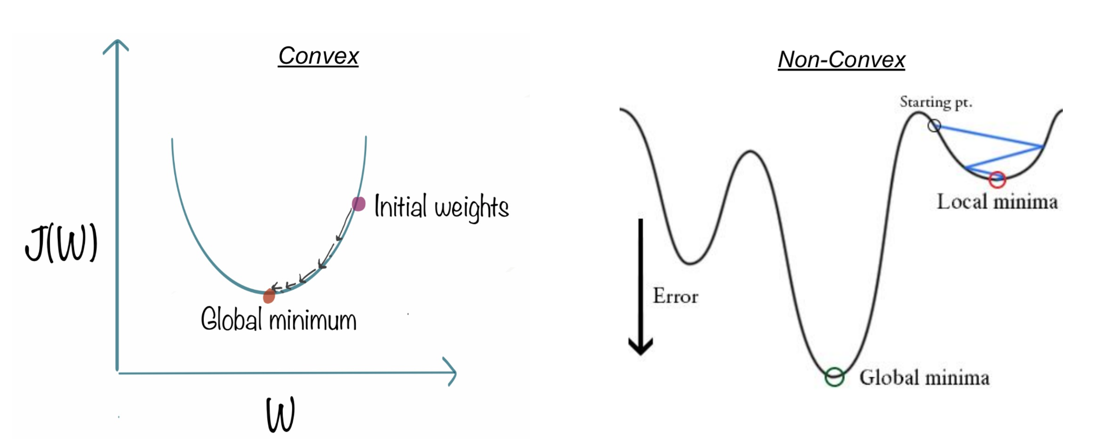
Loss function: Least Square Error has local minima
Do you remember that Linear Regression used a Least Squared Error loss function to minimise the errors? Here we can’t, because we have local minima. We use the Cross Entropy Loss function.

Slide 29
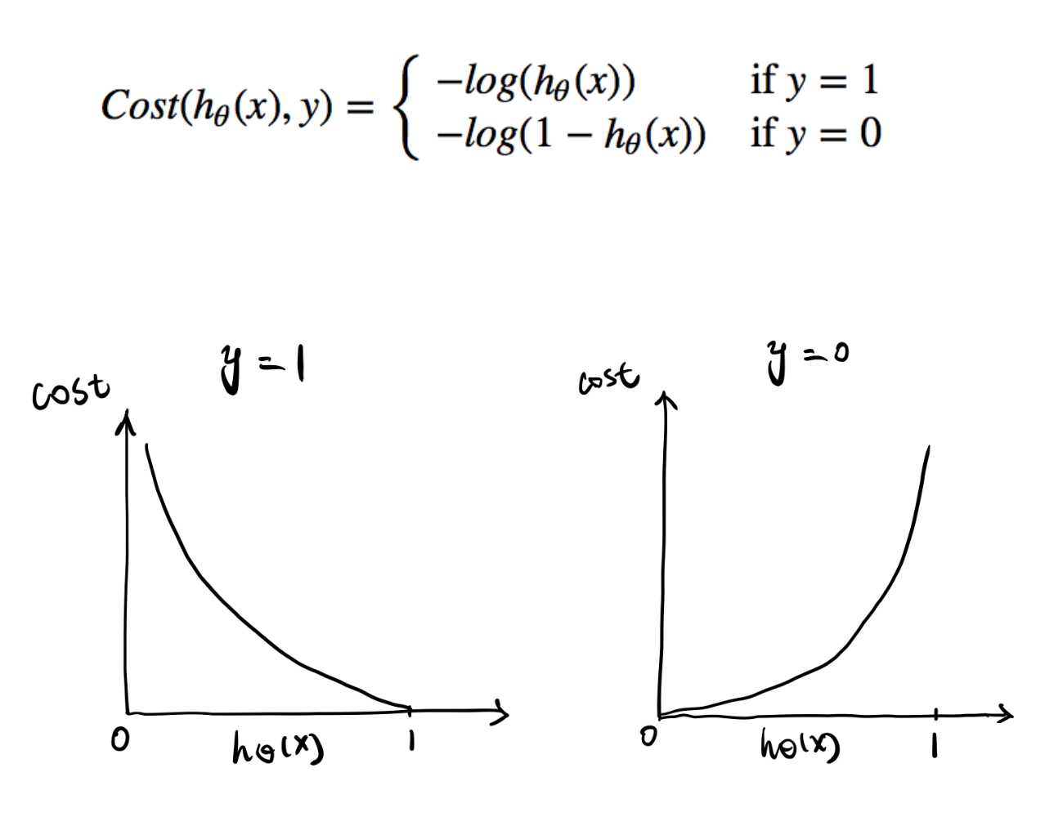
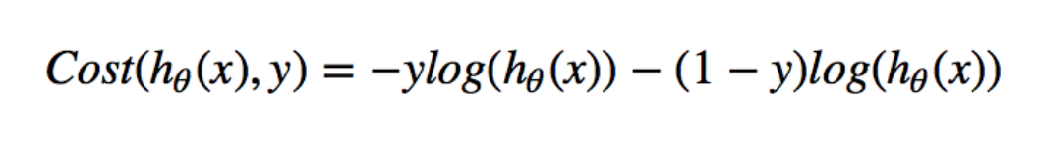
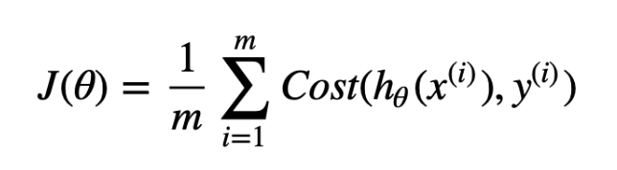
Loss function: intuition
Actual
Actual
Intuitively, we want to assign more punishment when predicting 1 while the actual (true) is 0 and when predict 0 while the actual (true) is 1. When the actual is 0 and true is 1 (or viceversa) the loss is infinite!

Slide 30
Rescaling of the features improve convergence speed
LogReg is based on Linear Regression, so Logistic Regression is a LINEAR model
Like for Linear Regression, the feature scaling improves the speed of convergence so it is advisable.
When you head about “Linear Model” in ML means that that model is able to make:
In case of regression → a linear hyperplane (rect, plane…)
In case of classification → a linear separation hyperplane
But we already know that a Linear Regression is able to fit a parabola if we
expand the feature space (dimensionality expansion): Logistic Regression hence can
make NOT linear separations!

Slide 31

Dimensionality Expansion
Adding more features, we are able to separate in a higher dimensional space with a plane!

Slide 32
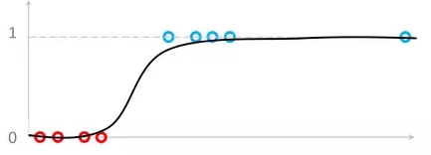
Outliers are dangerous...
More details about Logistic Regression
Logistic Regression is very sensitive to outliers. In fact the loss function guides the parameters of the formula so that the error is minimum.
Outliers are dangerous because they can lead to a completely wrong Linear Regression!
LINK

Slide 33
Support Vector Machines
SVM

Slide 34
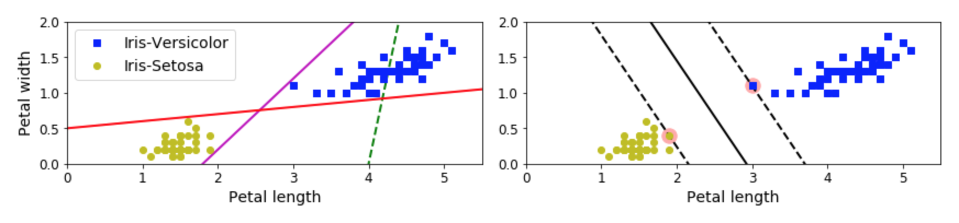
Technique 3: Support Vector Machine Classifier
SVM (Support Vector Machine) is a smart way to both classify (SVM classifier) and make regression (SVM regressor).
It is based on the concept of “Support Vectors”: we see here an example
The hyperplane generated is in black is the best because it create the biggest margin separating the 2 classes. The arrows indicate the so called “Support Vectors” that simply are the closest samples between the 2 classes.

Slide 35
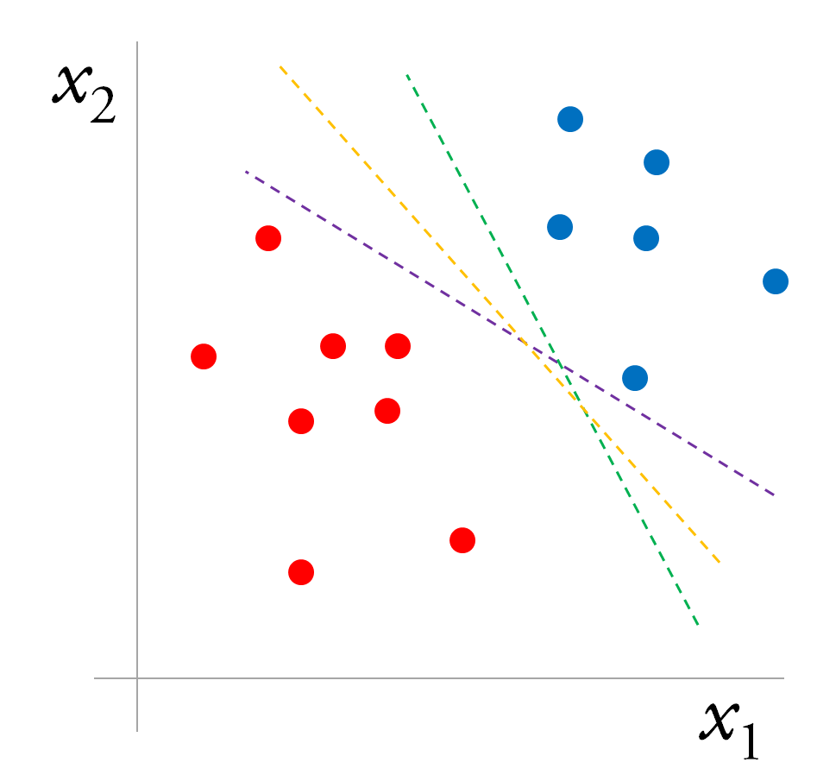
Technique 3: Support Vector Machine Classifier
SVM (Support Vector Machine) is a smart way to both classify (SVM classifier) (and also make regression (SVM regressor) but now we focus on classification)
A Question: which is the best separation boundary?
It is the yellow one since it creates “more margin” between the 2 classes (red and blue).

Slide 36
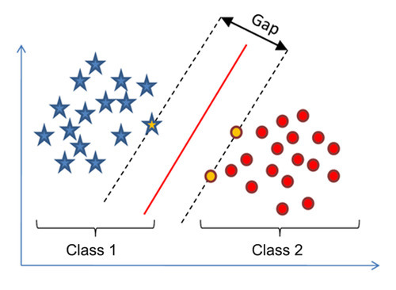
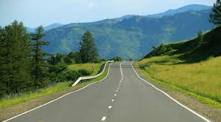
Hard Margin SVM Classifier
In fact, SVM classifier finds the separation hyperplane with the biggest “gap” (margins) to the 2 classes.
SVM in fact is also called “Large Margin Classifier”.
Now, imagine that the red line is the middle of a street and the margins (dashed lines) are the boundaries of the street.
If we want is to separate perfectly the 2 classes (stars and circles) we need them not to violate the margins = not to stay in the street. This is called HARD MARGIN SVM classifier:
In HARD MARGIN classifier no samples stay in the street. The objective is having the street as large as possible with NO margin violations

Slide 37
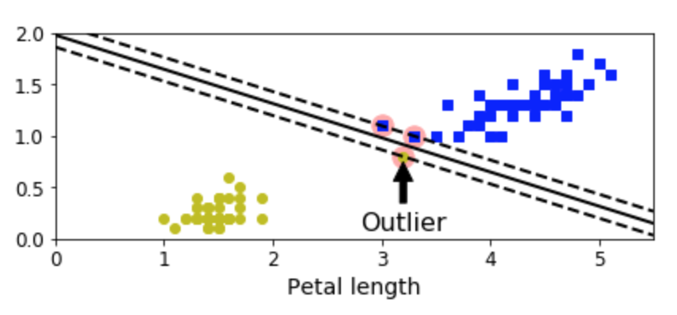
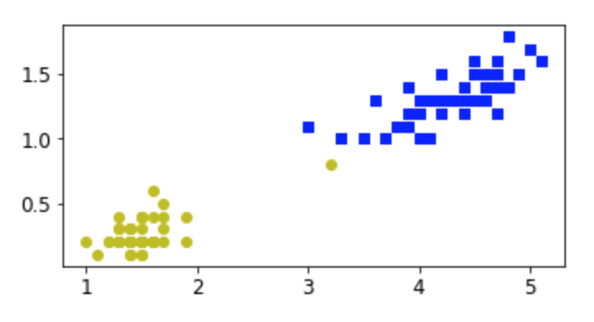
Soft Margin SVM: tolerate the margin violation
In the example, only 1 yellow sample is guilty to be very close the blue samples!
If we apply HARD margin, the street would be soooo narrow and it would be not a good separation hyperplane.
What to do? We must admit and tolerate some errors in order to have a biggest margin.
In SOFT MARGIN classifier we are more tolerant and we admit some margin violations.
The objective is to find a good balance between keeping the street as large as possible and limiting margin violations

Slide 38

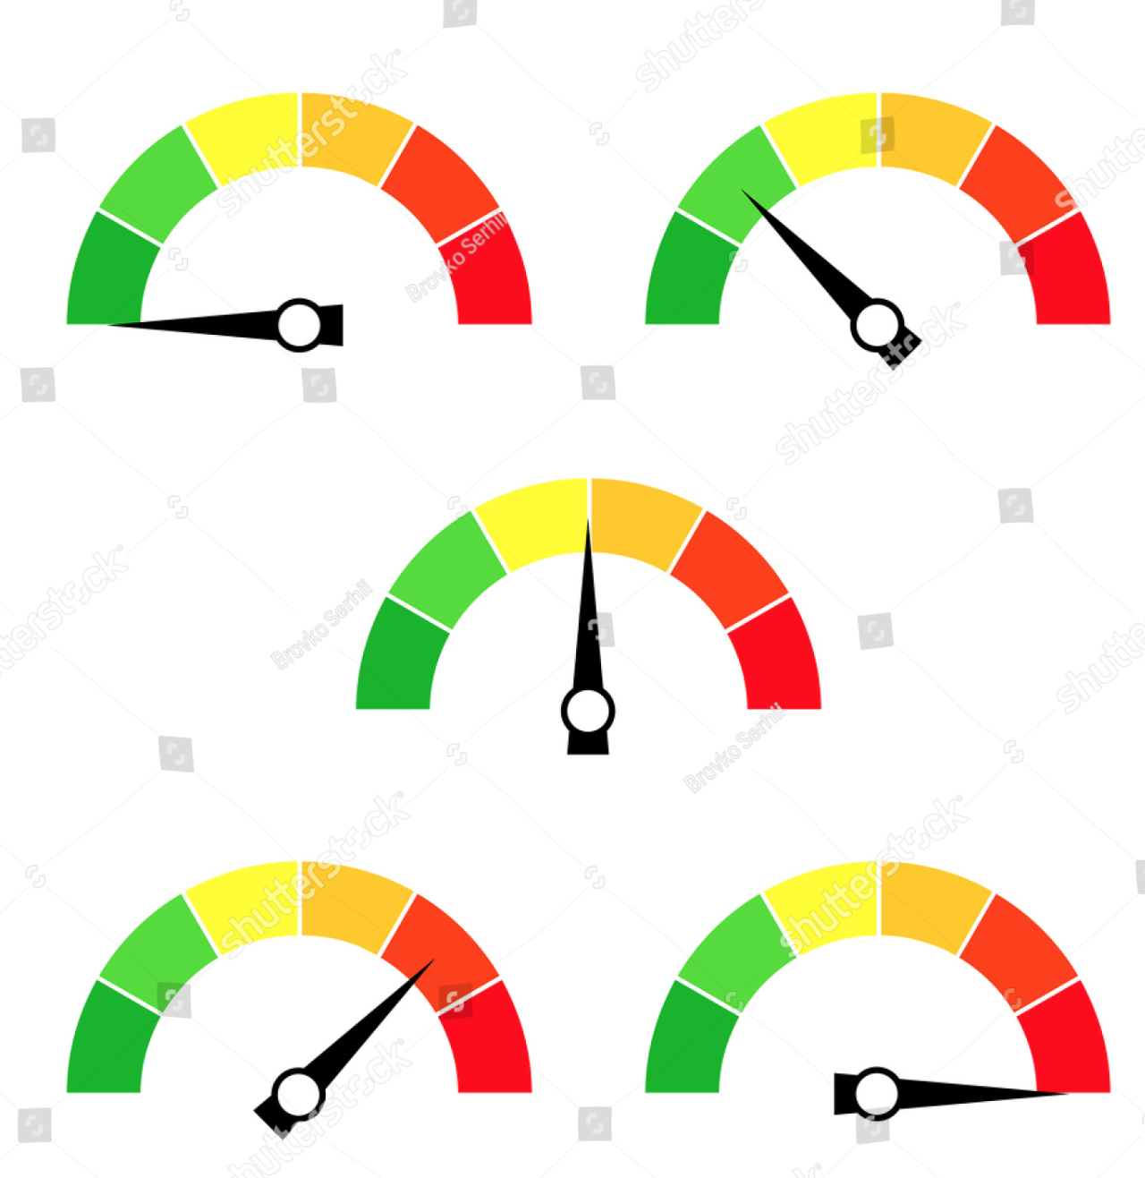
What is a Support Vector Machine Classifier?
What is Hard and Sorf Margin?
Also called “Large Margin Classifier”, it is a classifier that tries to separate as well as possible the classes making the biggest margin among them. Like a street, the middle is the decision boundary and the sides are the margins.
In Hard Margin we don’t admit margin violations (samples in the street, invading the street) and the model penalizes heavily this violation and having the “street” as large as possible.
In Soft Margin, the model admits violations of samples to be in the street, it is more tolerant. The objective is to find have the “street” as large as possible, limiting margin violations.

Slide 39
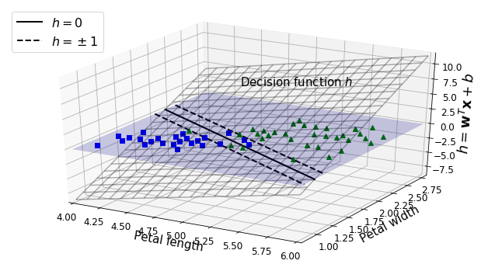
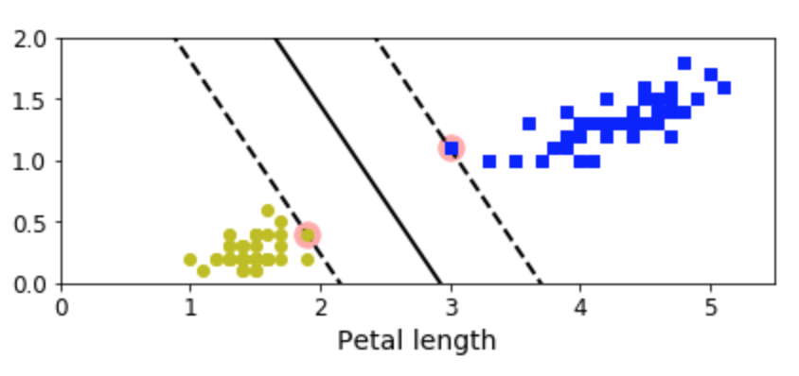
Intuition about Support Vectors
This is a picture depicting the same situation in 2d and 3d plots. Since the goal is maximizing the margins, the SVM classifier algorithm tries to “lay down” the hyperplane as much as he can until touching the support vectors.

Slide 40
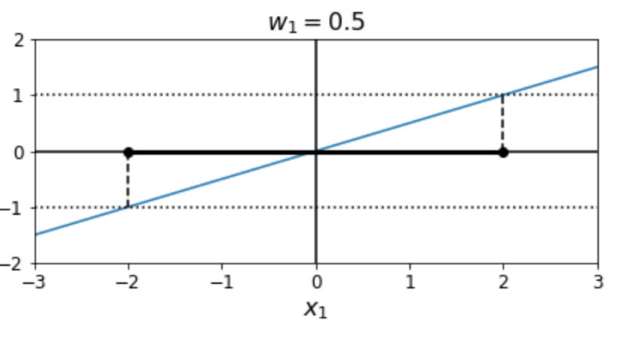
Intuition about Support Vectors
On the right you see the plane (blue) leaning (appoggiarsi, apoyarse) to the support vectors. It is like the support vectors are sustaining (sostenendo, sostener) the hyperplane.
This is why they are called support vectors.

Slide 41

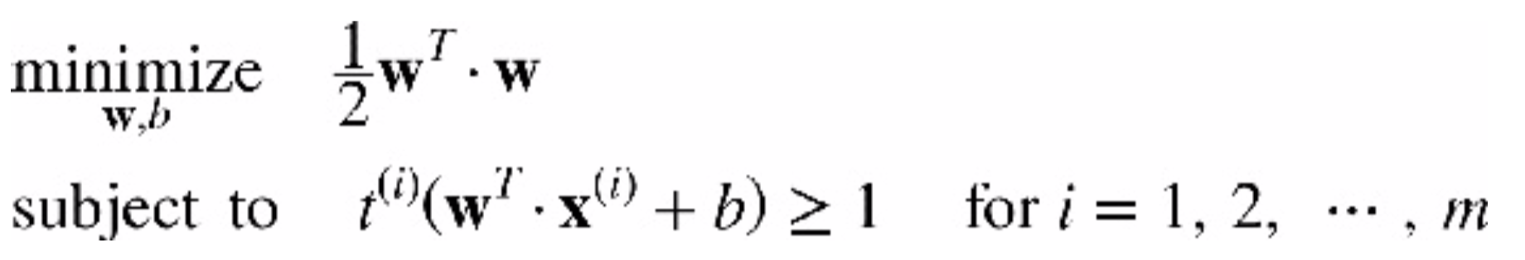
Loss function (for the most curious)
This could happen to be an interview question (the formula) but not crucial to know it, trust me.
This is not necessary to know, but sometimes in interviews they could ask you this:
y
This is a constrained minimization: minimize the W with constrain:
1 - First equation: I want the W as small as possible!
2 - Second: Hey, ok, you want W as small as possible...but I need that
the positive samples (y = 1) are on the hyperplane with value >=1 and
the negative (y = -1 samples) need to stay on the hyperplane with values <= -1.
THIS IS VALID ONLY FOR HARD MARGIN SVM CLASSIFIER

Slide 42
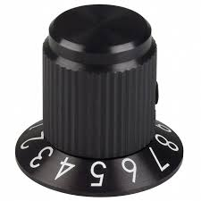
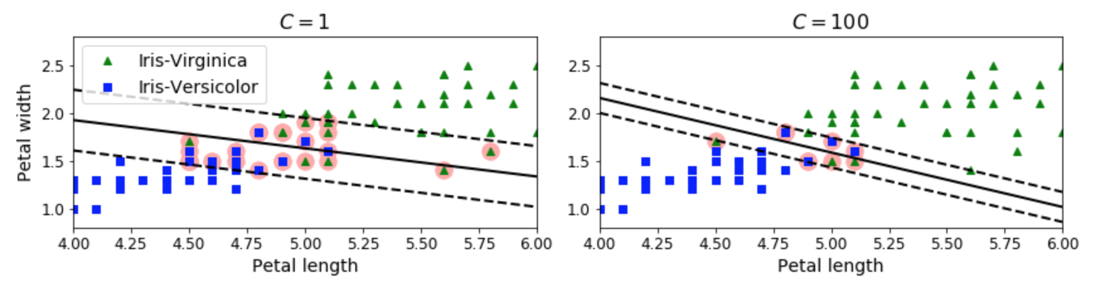
Soft Margin: the C parameter
Hey! The soft margin SVM tolerate errors...but how many errors?
The C parameter tells you how much “tolerant” to
margin violations is the model
C knob
LOW C → admits more errors (more violations, wider street)
HIGH C → admits less errors (less violation, narrowe street)
INFINITE C → Hard Margin SVM Classifier

Slide 43
Soft Margin: the C parameter
Hey! The soft margin SVM tolerate errors...but how many errors?
C is a value that can be used to regulate how the model is tolerant to margin violations.
In case of Overfitting, REDUCE C parameter
C knob

Slide 44
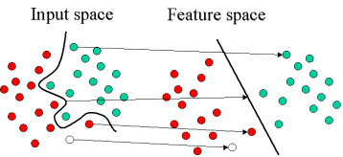
Kernels: what are they? Can a plane separate NON linearly separable data? YES!
With SVM you will frequently hear about Kernels. They are essentially methods to transform data into a different space so that, in the new space, they are LINEARLY separable with a plane.
In fact, we already saw that data NOT linearly separable in a space, but can be separable in an higher dimensional space after a transformation.
Recall the Linear Regression problem: the parabola can be fitted in a higher dimensional space). The mechanism is very similar.

Slide 45
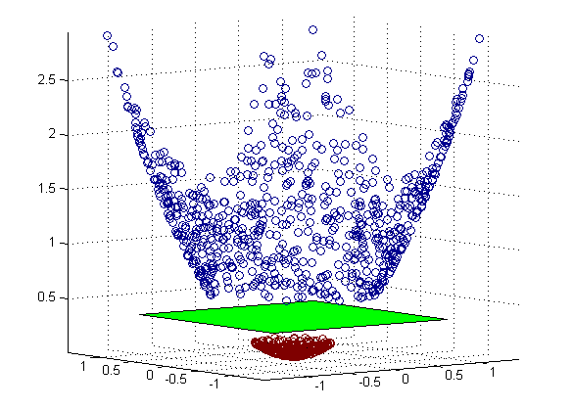
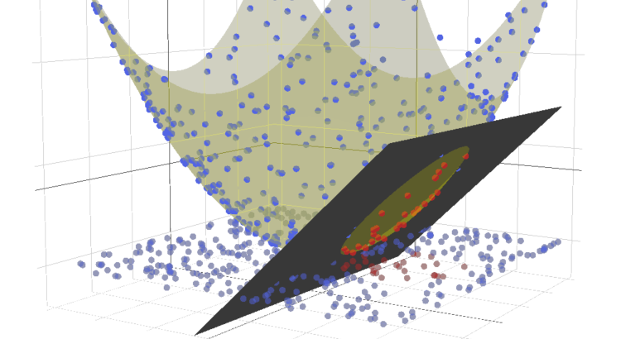
Polynomial Kernel
The Polynomial Kernel creates higher degree of the features (Polynomial features) but SVM has a kernel trick, where the features are not really added to the dataset (thanks to the kernel trick): this speed up a lot the computation.
In the starting dimension, the data is not linearly separable.

Slide 46
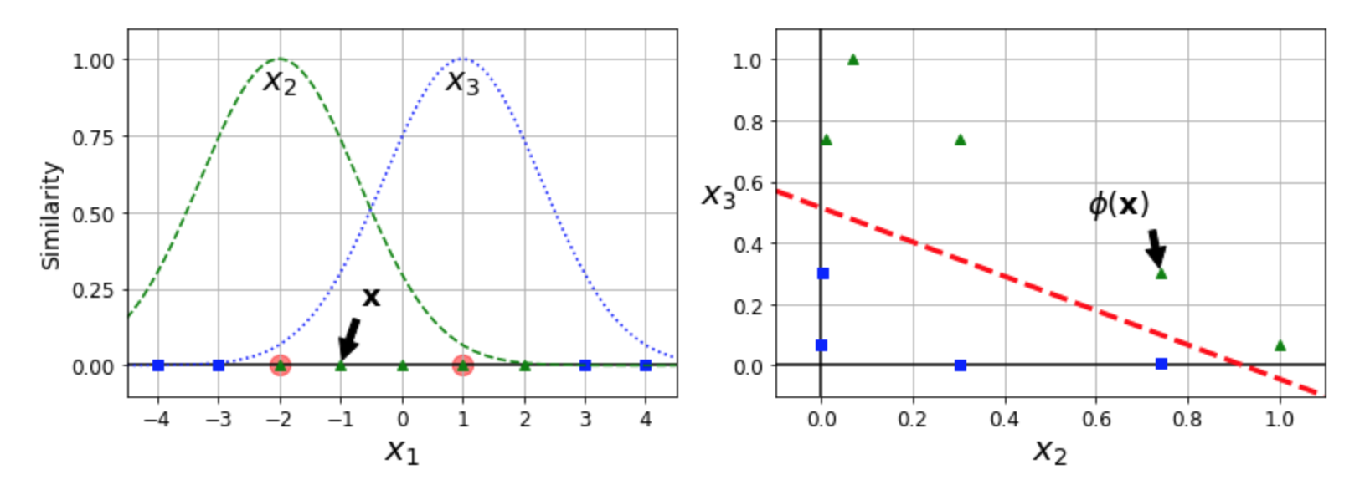
Gaussian Kernel: adding similarity features
The Gaussian Kernel “virtually add” more features (without calculating them) describing the similarity between features.
The features added describe the similarity between samples.
This “adding features” is like expand the dimension of the data.

Slide 47
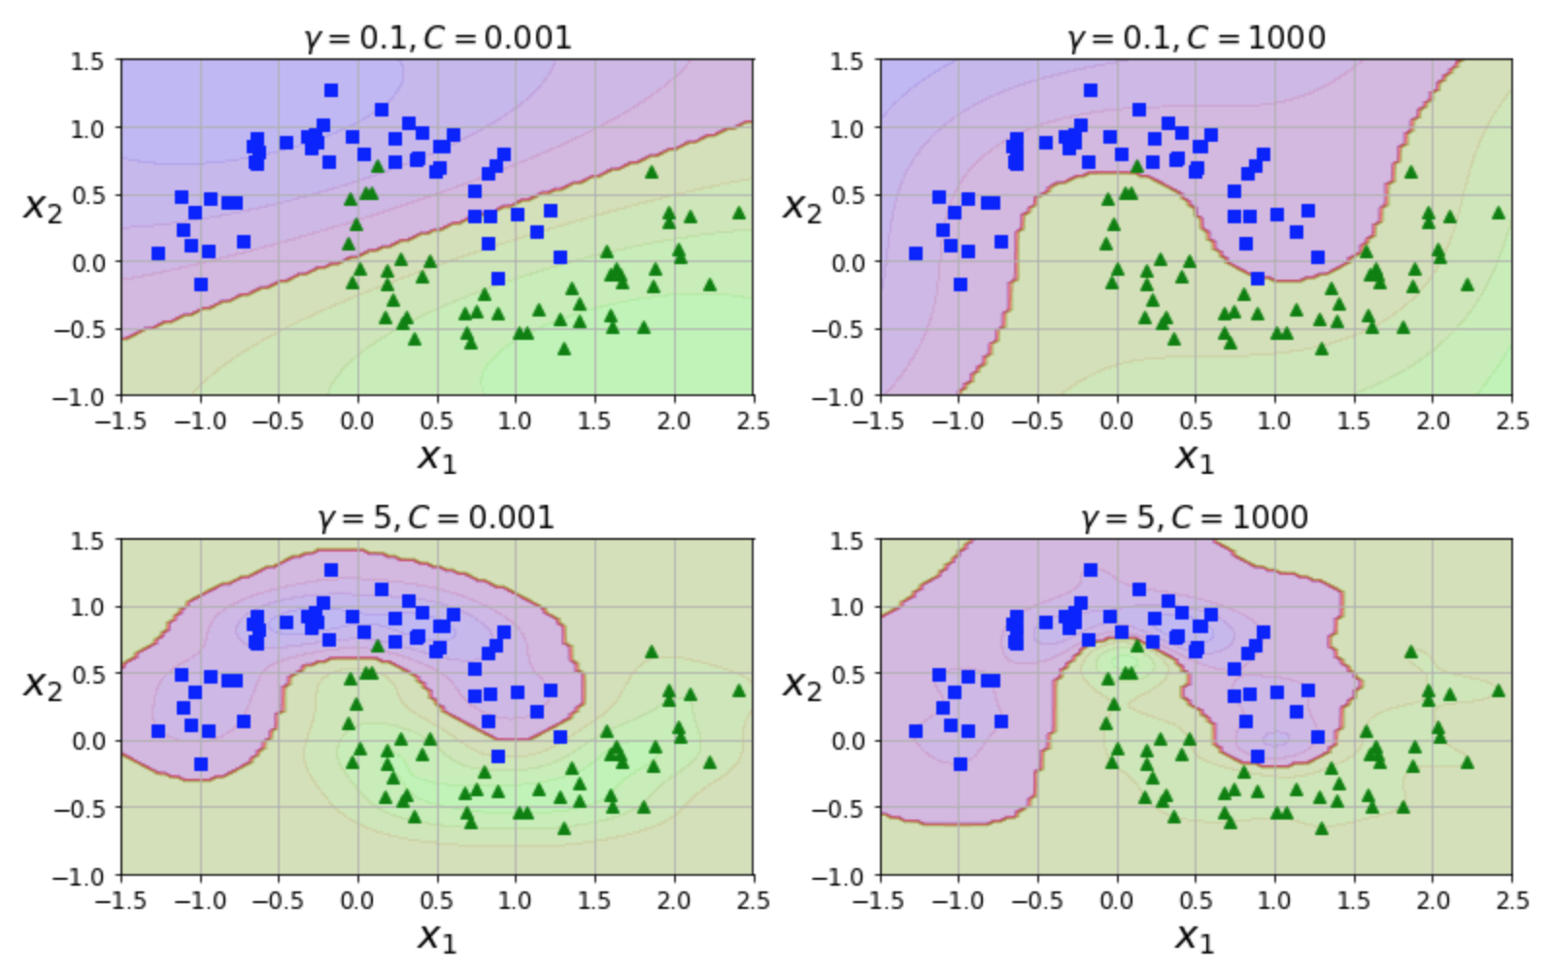
Kernels Knobs
Used to regulate the flexibility of the models. Just for example: this is a gaussian kernel. Gamma value regulates the flexibility of the model.

Slide 48
What are kernels in SVM classifiers?
When data are not linearly separable by a “line”, we can use kernels. There are many kernels, but the most famous are:
Polynomial Kernel
Gaussian Kernel
Kernels transform (map) the data into a different space where data hopefully are linearly separable.
In fact, a linear separation in a different space corresponds to a non linear separation function in initial space. The Kernel don’t actually calculate and add the new features values by really transforming the features, but use the kernel trick, that is a mathematical trick that is able to know the characteristic of the samples in the new space with no data transformation. This speed up A LOT the computation.
The kernels have also KNOBS to tune the flexibility of the model.

